Slide 1
System analysis of the Interleukin-21 signaling in CD4+ T cells
Jan 7, 2014

Slide 2
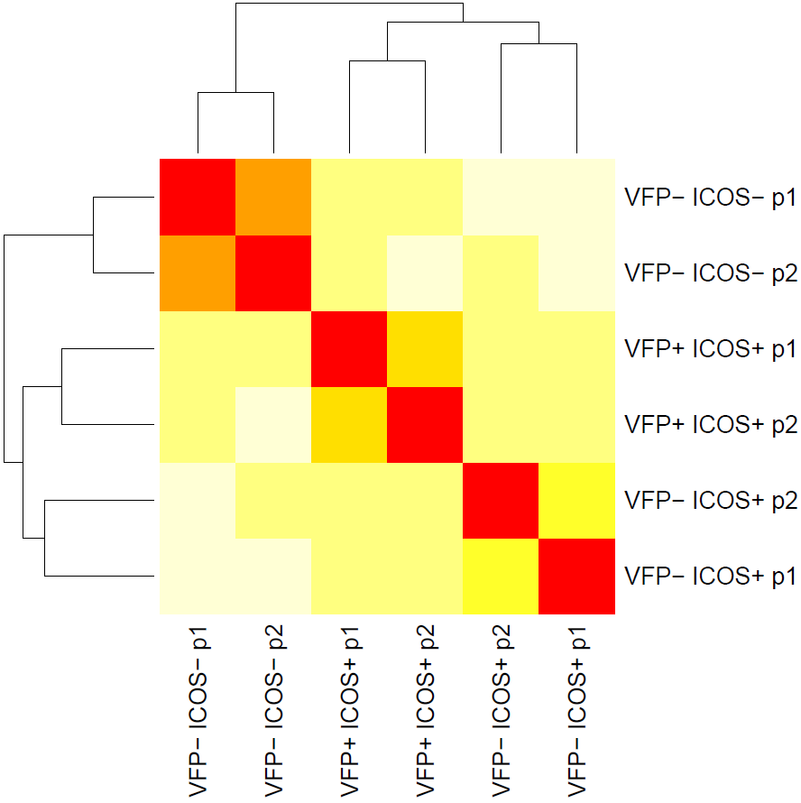
Expression profiles and significant genes
Quality control
RSEM (GRCm38)
EBSeq
Approximately 80% of reads kept for downstream analysis
Align reads to reference transcriptome
Call read counts for transcripts
Call significant genes and isoforms
VFP-ICOS-
IL21-VFP negative, ICOS negative, p1/p2
VFP+ICOS+
IL21-VFP negative, ICOS negative, p1/p2
VFP-ICOS+
IL21-VFP negative, ICOS negative, p1/p2
R: Heat map plot Euclidean distances between samples
./rsem/

Slide 3
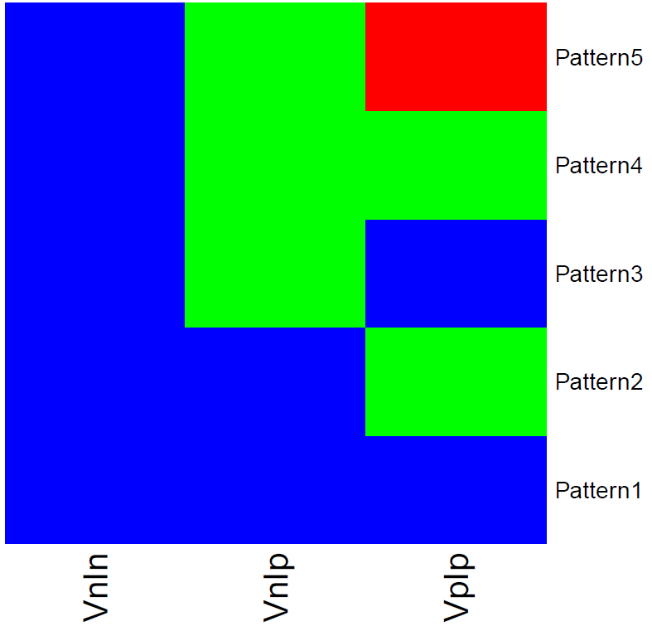
Significant genes and isoforms in each pattern
Genes | Isoforms
352 | 406
452 | 452
219 | 444
188 | 338
7658 | 19458
VFP⁻ ICOS⁻
VFP⁻ ICO⁺
VFP⁺ ICO⁺
Total of 18837 genes and 48286 isoforms examined.
./mygenelist_symbol
./Lupus_ppmeanslog2fc

Slide 4
IL-21 expression
Posterior probability of IL21 expression in each pattern
Mean expression in each group
NN
NP
PP
Log2 fold change over groups
NN/NP
NN/PP
NP/PP
1
2
3
4
5
./mygenelist_symbol
./Lupus_ppmeanslog2fc

Slide 5
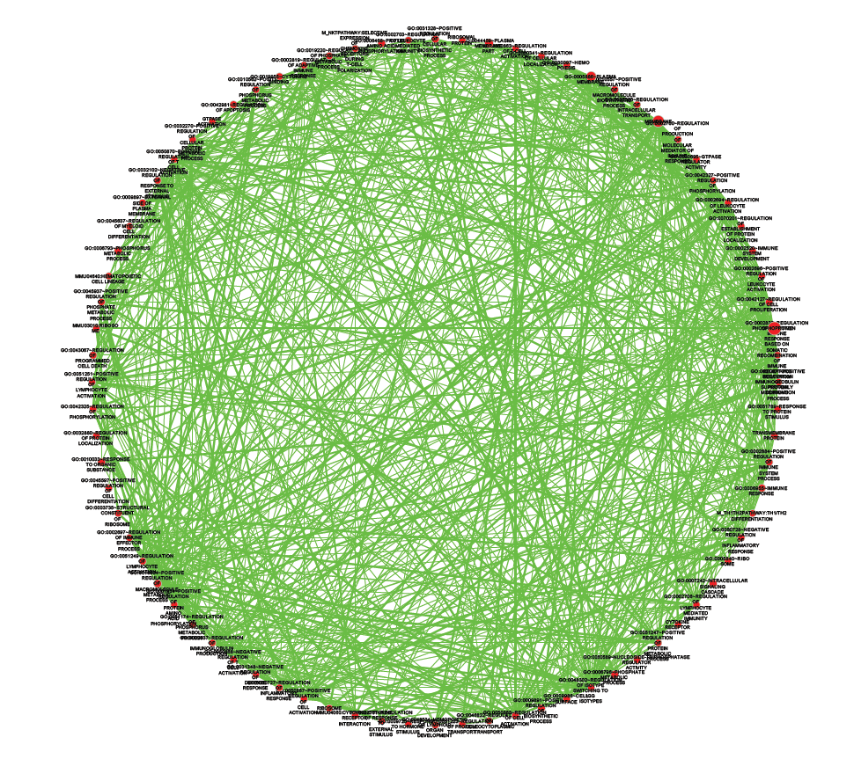
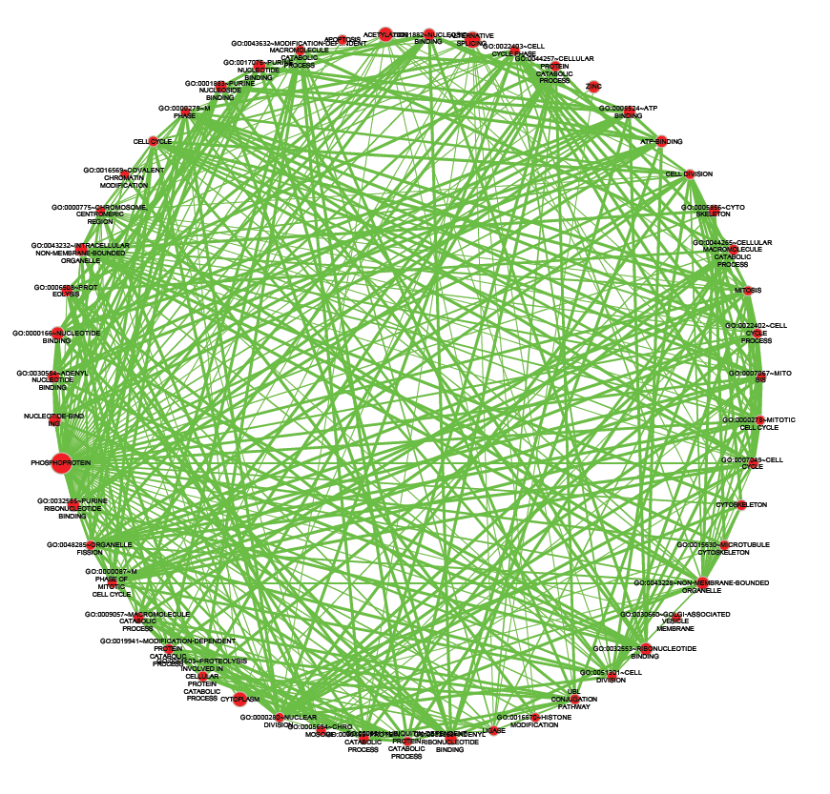
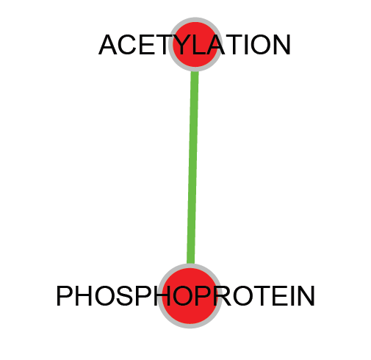
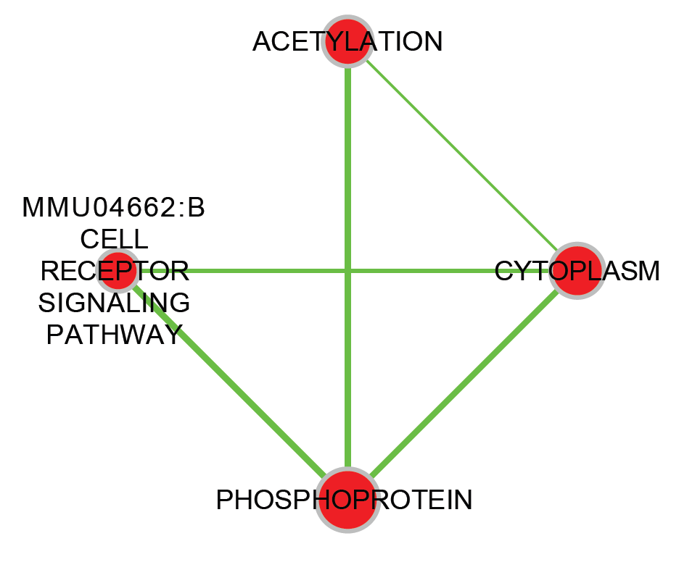
Functional Annotation Enrichment
Significant genes from EBSeq
DAVID
Cytoscape
Pattern 2
Pattern 3
Pattern 4
Pattern 5
./DAVID/
./DAVID/FunctionalAnnotationChart.xlsx
./DAVID/FunctionalAnnotationClustering.xlsx

Slide 6
Expression profiles correlation
214 Immgen datasets
3 Liu’s data
3 Lupus data (TPM)
RMA normalization
Background correction
Background correction
Intensity values of expressed genes in each datasets
TPM values of expressed genes
Signature genes from Lupus data
Correlation and PCA

Slide 7
Expression profiles correlation
Liu
NK Cells
Neutrophils
Monocytes
Stem Cells
B Cells
Dendritic Cells
Macrophages
NK Cells
αβ T Cells
γδ T Cells
Stromal Cells
./Corr/

Slide 8
Expression profiles correlation
./Corr/

Slide 9
Expression profiles correlation
VFP-ICOS-
VFP-ICOS+
VFP+ICOS+
./Corr/

Slide 10
PCA clustering of top correlated samples
./PCA/

Slide 11
PCA clustering of top correlated samples
vfp.neg.icos.neg
vfp.neg.icos.pos
Vfp.pos.icos.pos
./PCA/

Slide 12
PCA clustering of top correlated samples
./PCA/MyPCA.[12].PC[12345].txt

Slide 13



cis-regulatory elements exploration
TSS
TF
Promoter (-350 to 50 bp of TSS)
EXON
Candidate regulators curated from the Jaspar and Homer databases that are expressed in the samples
 | Runx1
 | Ap2a
 | Nfat
Motif enrichment
Known motif comparison
./Homer/

Slide 14
Terhost et al., 2013 genes
*5
*5
*4
*5

Slide 15
Some genes
*5
*5
*4
*3
P2 for Bcl6 = 0.9479

Slide 16
Significant genes in double positive sample
Pattern 2
Genes in Pattern 2 that are also 1 times higher in +/+ than either of the other 2 groups. The max read counts larger than 100.

Slide 17
Significant genes in double positive sample
Pattern 2
Genes in Pattern 2 that are also 1 times less in +/+ than either of the other 2 groups. The max read counts larger than 100.

Slide 18
Significant genes in double positive sample
Pattern 5
Genes in Pattern 5 that are also 1 times high in +/+ than both of the other 2 groups. The max read counts larger than 100.

Slide 19
Significant genes in double positive sample
Pattern 5
Genes in Pattern 5 that are also 1 times less in +/+ than both of the other 2 groups. The max read counts larger than 100.

Slide 20
The 1675 Transcriptional factors
2 times higher or ½ times less expression in double positive than the other 2 groups. The max read counts larger than 20.

Slide 21
Top regulated genes in double positive sample
4 times higher or ¼ times less expression in double positive than both the other 2 groups. The max read counts larger than 100.

Slide 22
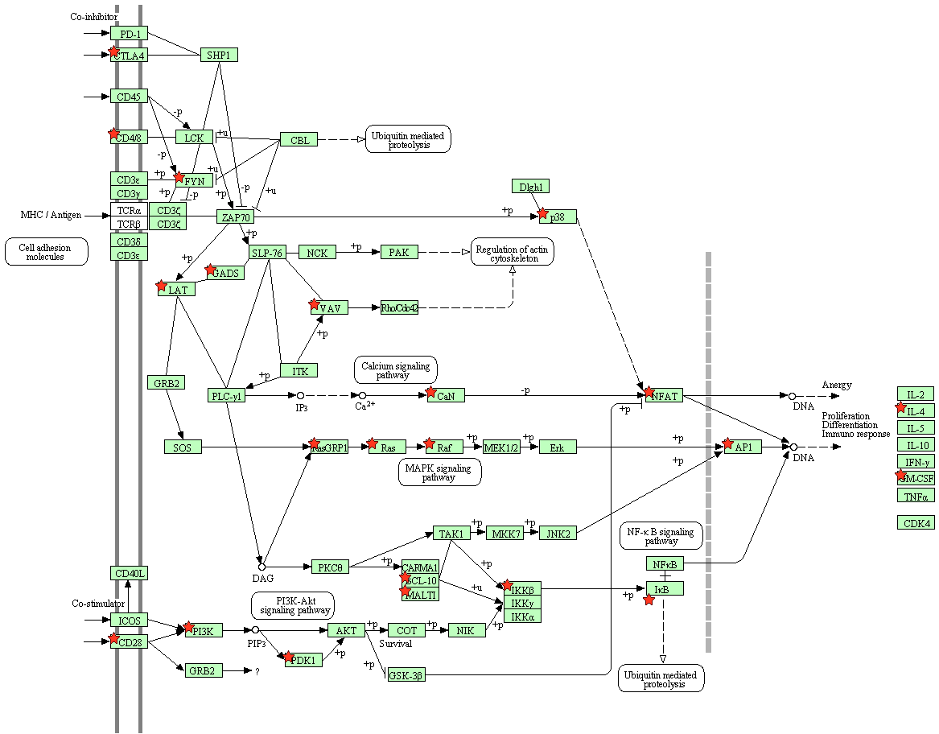
KEGG pathway 1: T cell receptor signaling

Slide 23
KEGG pathway 1: T cell receptor signaling

Slide 24
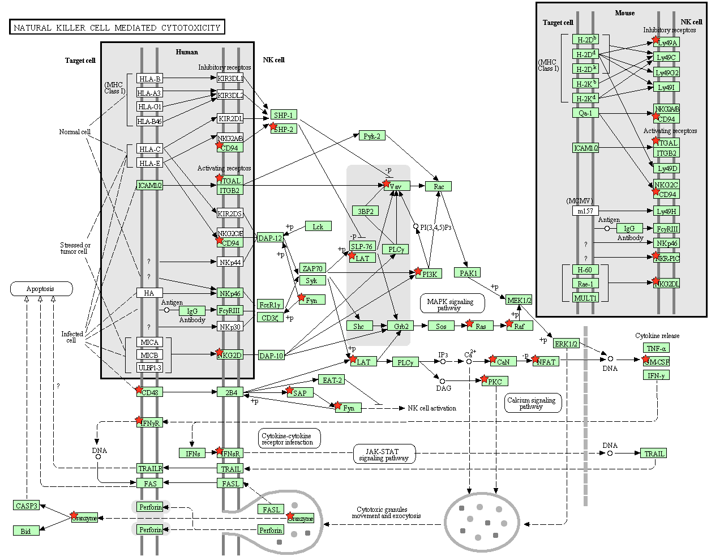
KEGG pathway 2: NK cell cytotoxicity

Slide 25
Cxcr5 – log2 fold change over conditions

Slide 26
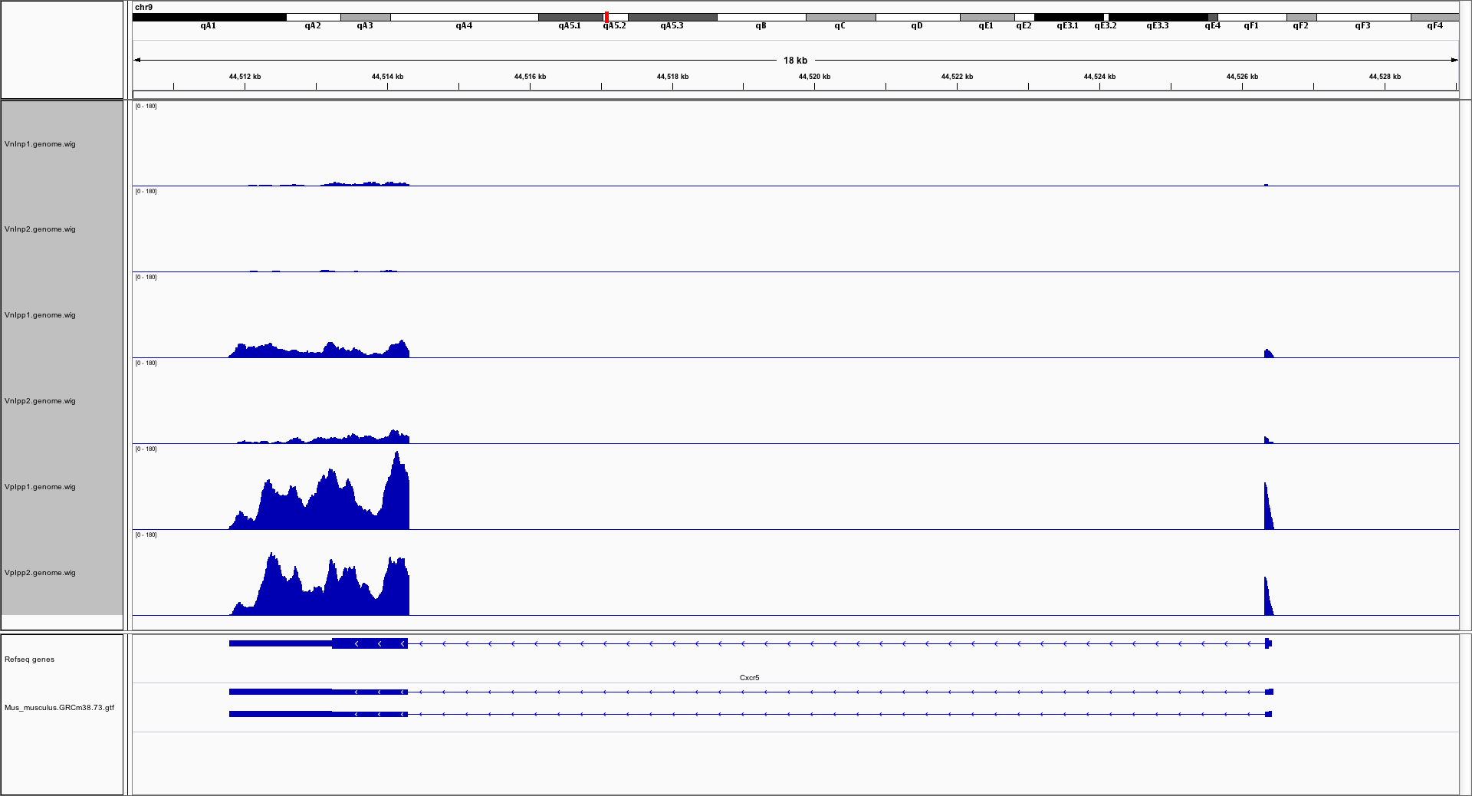
Cxcr5 – alignment details

Slide 27
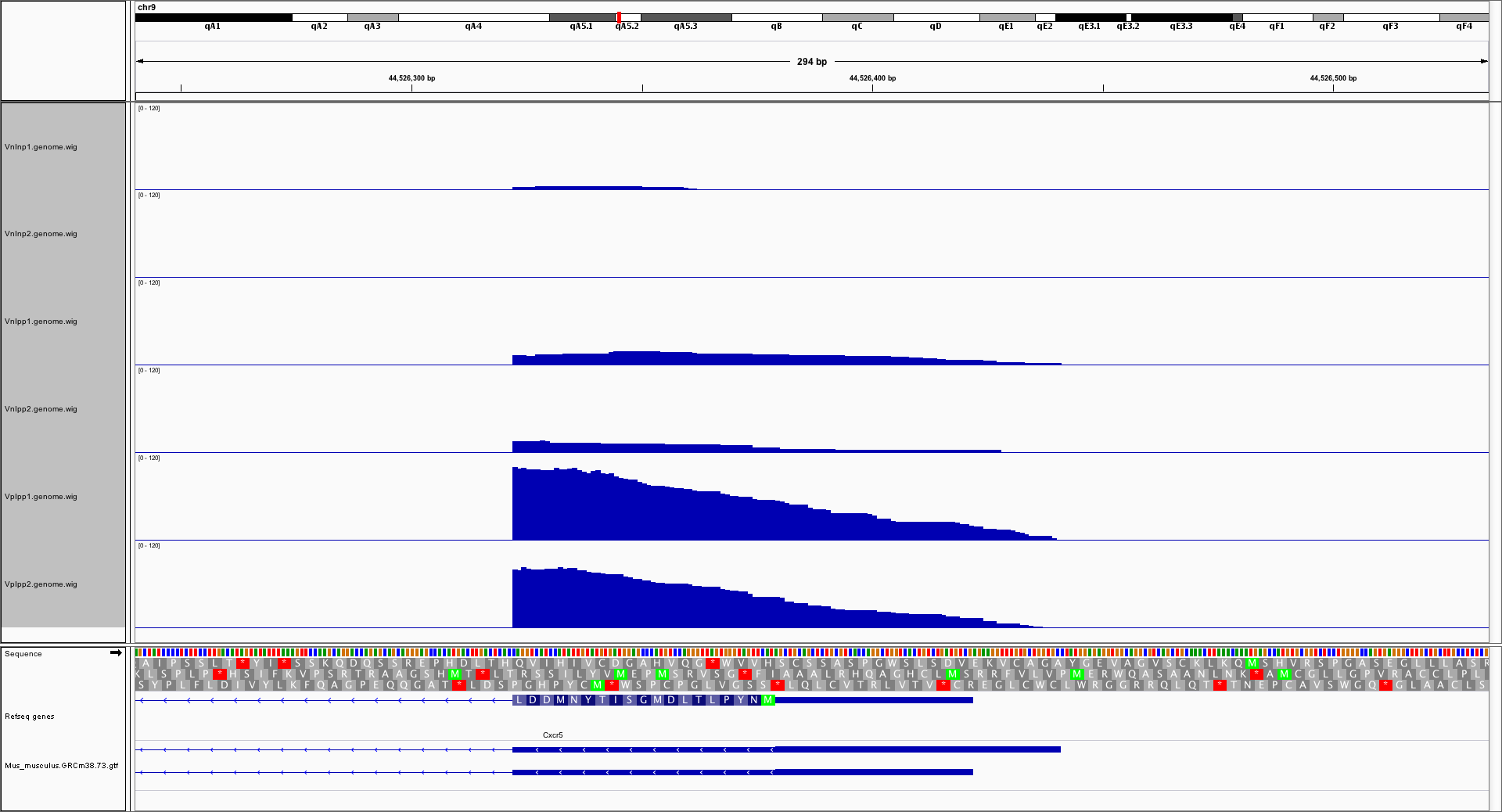
Cxcr5 – alignment details

Slide 28
Cxcr5 – assigned read counts for isoforms

Slide 29
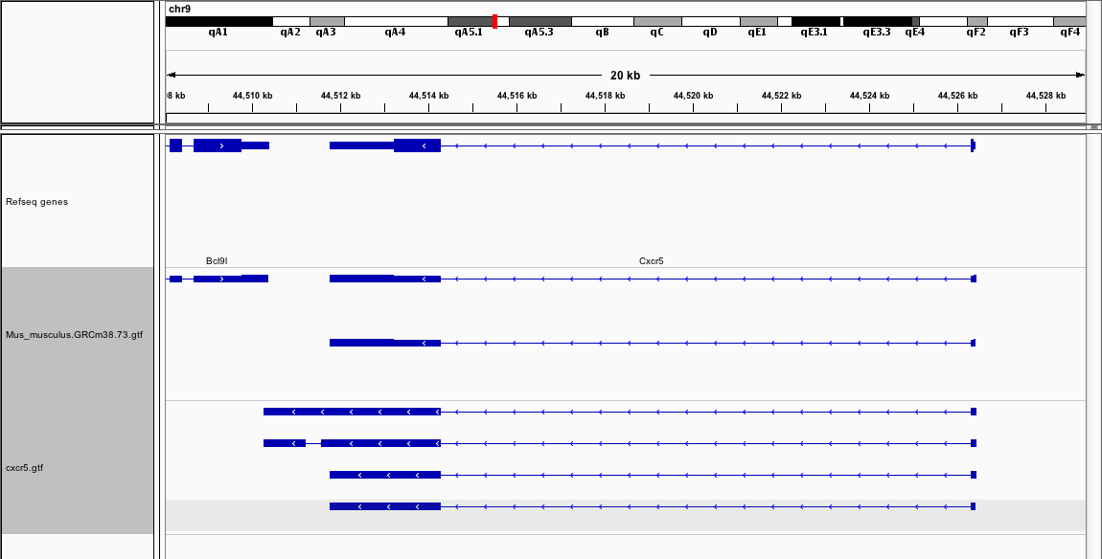
Cxcr5 – from cufflinks
Cufflinks defined 4 isoforms, which can be correlated with the 2 official ensembl isoforms based on the 3’ features
Cufflinks isoforms 1-3 are defined by their 5’ variations

Slide 30
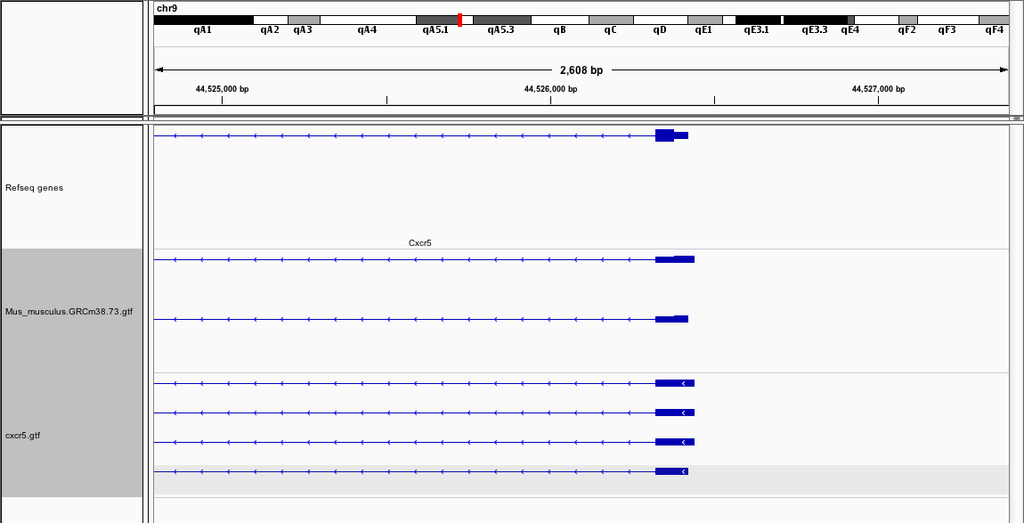
Cxcr5 – from cufflinks
Ensembl annotations
Cufflinks annotations
Cufflinks defined 4 isoforms, which can be correlated with the 2 official Ensembl isoforms based on the 3’ features
Cufflinks isoforms 1-3 are defined by their 5’ variations

Slide 31
Cxcr5 – from cufflinks
Cxcr5 is by adding cufflinks isoforms 1-4 together
Cxcr5-iso1 is by adding cufflinks isoforms 1-3 together
Cxcr5-iso2 is the cufflinks isoform 4

Slide 32
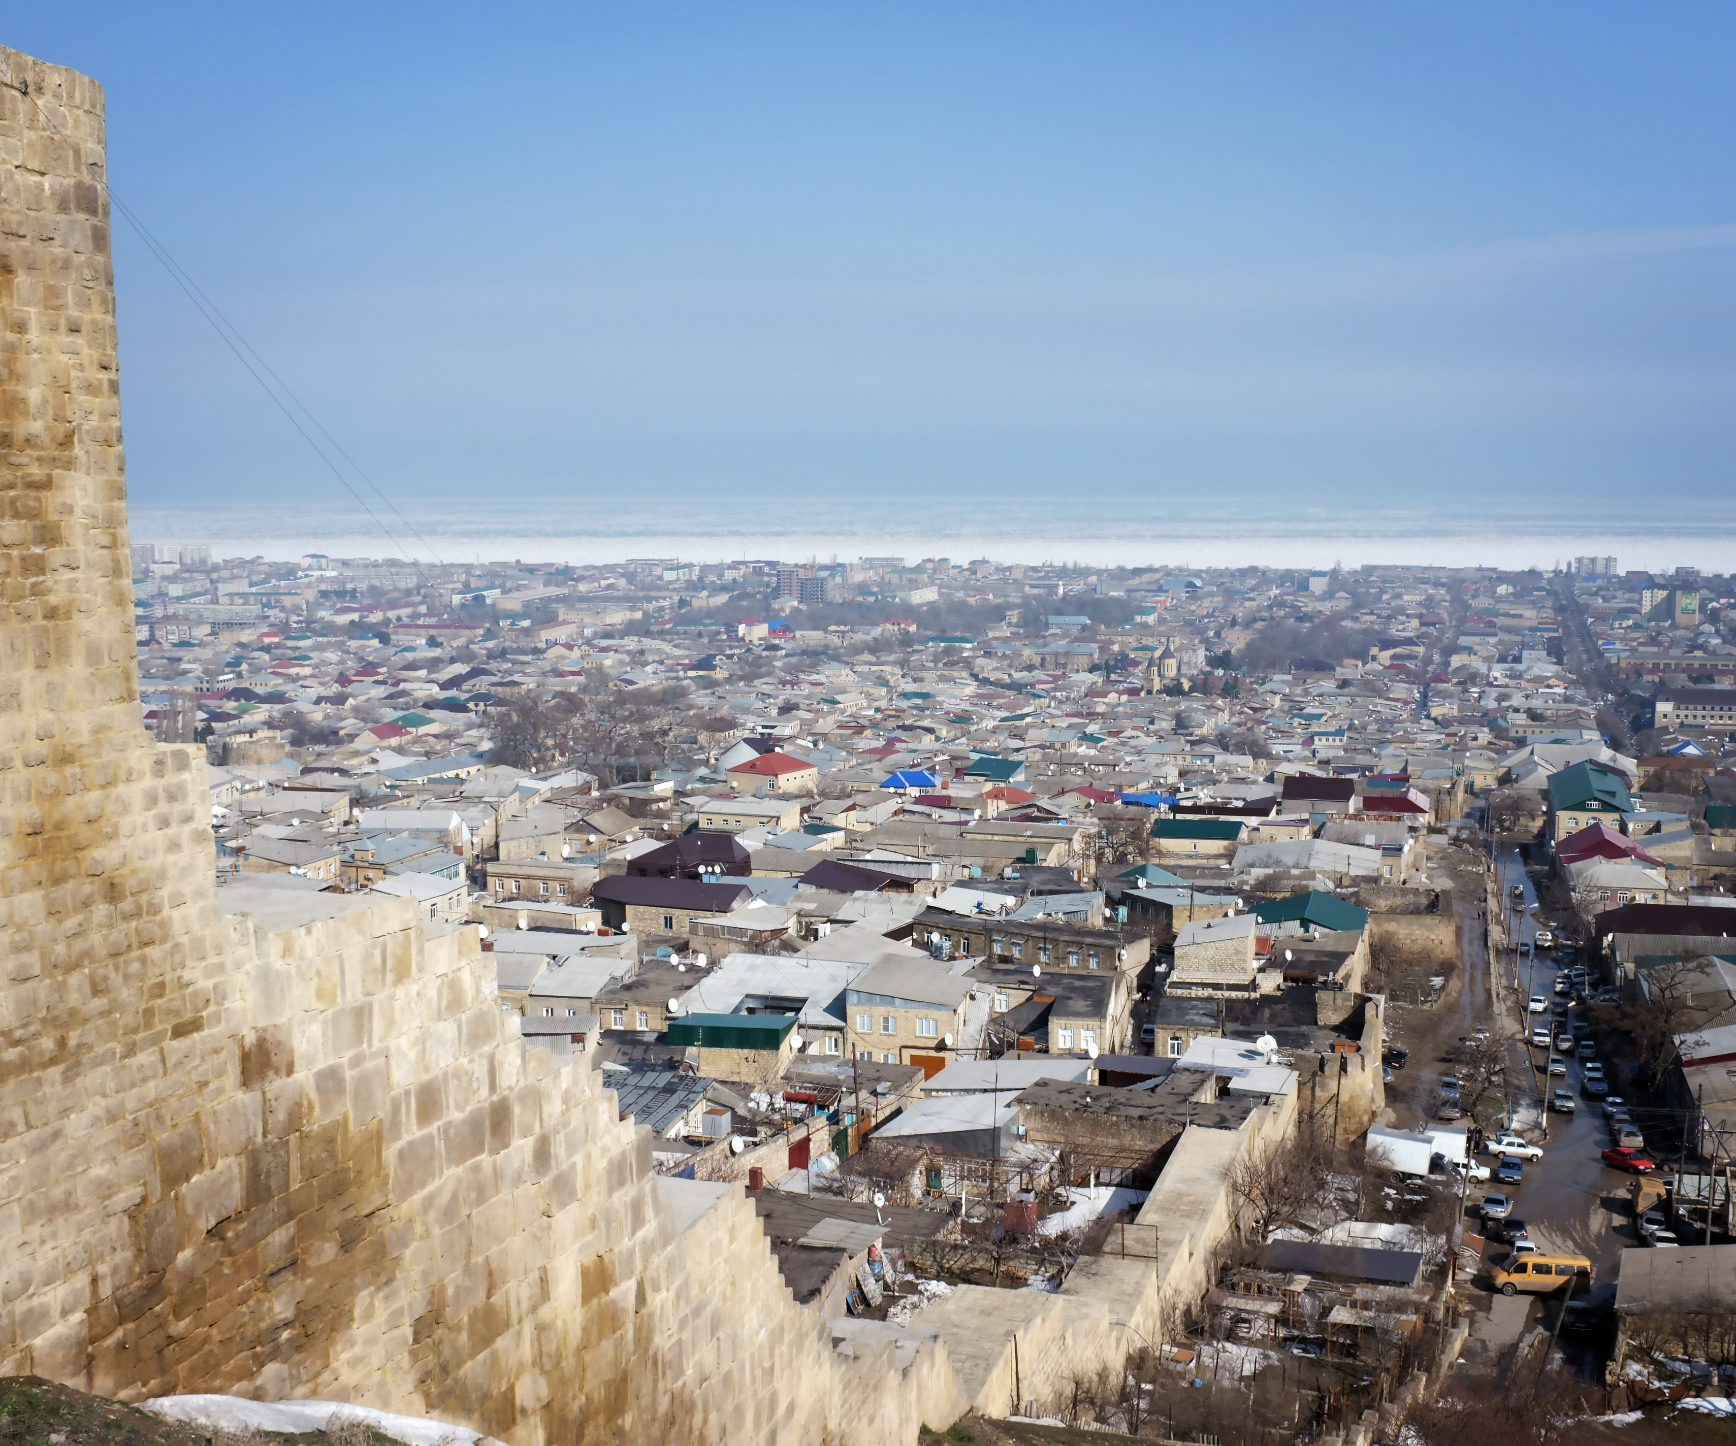
Thanks.

Slide 33
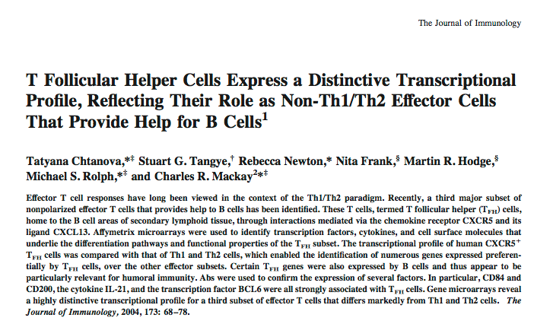
Human TFH

Slide 34
Human TFH
T Follicular Helper Cells Express a Distinctive Transcriptional Profile, Reflecting Their Role as Non-Th1/Th2 Effector Cells That Provide Help for B Cells
Journal of Immunology, 2004

Slide 35
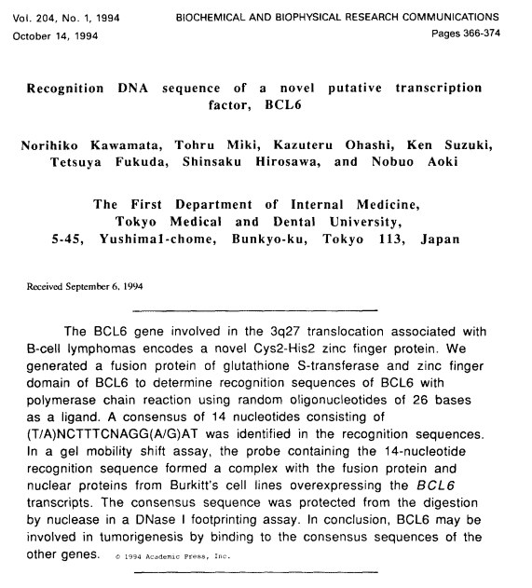
Bcl6 sites in JASPAR

Slide 36
Bcl6 sites in JASPAR

Slide 37
Bcl6 sites in JASPAR

Slide 38
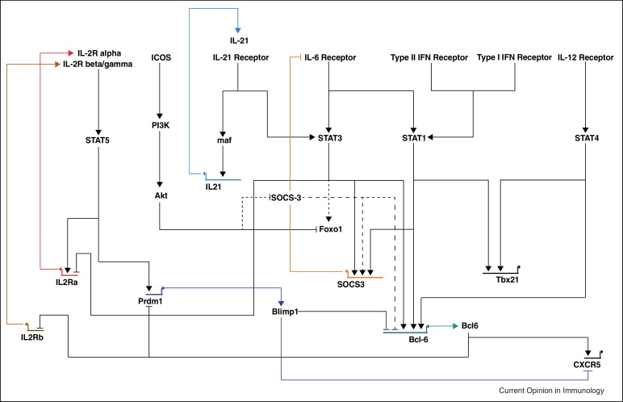
Pathway

Slide 39
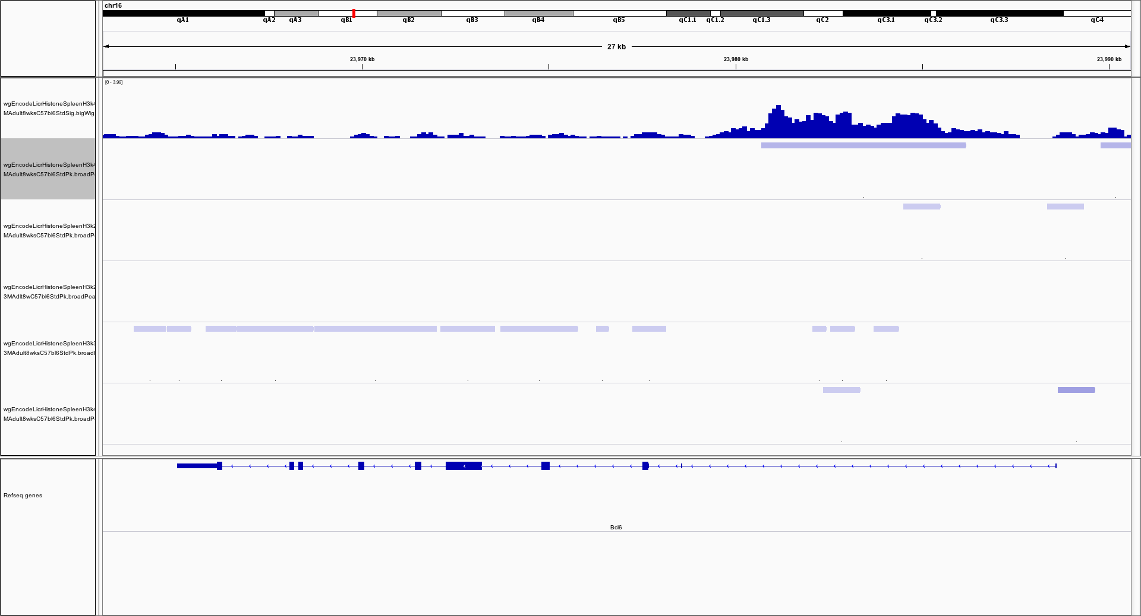
Mouse Encode Histones in Spleen
H3k4me1
H3k4me1
H3k4me3
H3k27me3
H3k27ac
H3k36me3

Slide 40
Mouse Encode Histones in Spleen
H3k4me1
H3k4me3
H3k27me3
H3k27ac
H3k36me3

Slide 41
Signature genes of TFH cells in our samples
TPM
Follicular helper CD4 T cells (TFH)
Crotty et al., 2011. Annu Rev Immunol

Slide 42
Some genes
TPM

Slide 43
Keizei et al., 2013

Slide 44
Il21

Slide 45
Bcl6

Slide 46
Cxcr5

Slide 47
VFP and Il21 transcripts

Slide 48
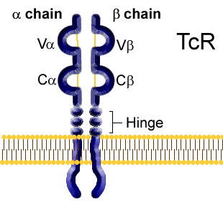
T cell receptor repertoire
V – 132
D – 2
J - 73
C
No reads

Slide 49
TCR-[alpha|beta]-V genes
55 V genes with maximal TPM larger than 5, standard deviation larger than 5

